Slide 1




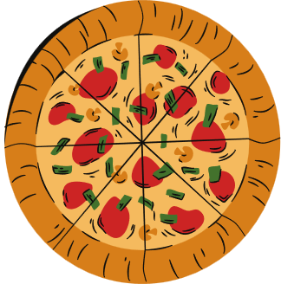

PIZZA
SALES ANALYSIS

Slide 2
PROJECT OVERVIEW:
The goal of this project is to empower stakeholders with valuable insights into sales patterns, popular pizza varieties and peak order times. By leveraging these insights, businesses can make informed decisions on inventory management, marketing strategies, and operational efficiency.
In this presentation, we’ll walk through the key features of the dashboard, highlighting how it can be used to optimize pizza sales and drive business growth by utilizing SQL Queries.
By : Rajat Chourasiya

Slide 3
KPI’S REQUIREMENT:
Total Revenue: The sum of the total price of all pizza orders.
Average Order Value : The average amount spent per order.
Total pizzas sold : The sum of the qualities of all pizzas sold.
Total Orders : The total number of orders placed.
Average Pizzas Per Order : The average number of pizzas sold per order.

Slide 4
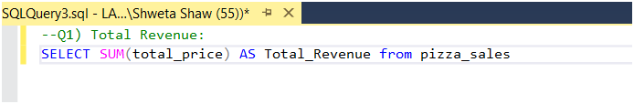
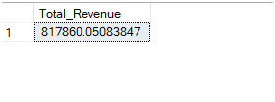



Q1.Calculate the total revenue:
Q2.Indicate the average order sales

Slide 5
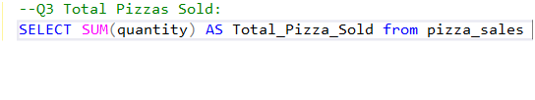




Q3.Calculate the total pizzas sold
Q4.Find out the total orders

Slide 6


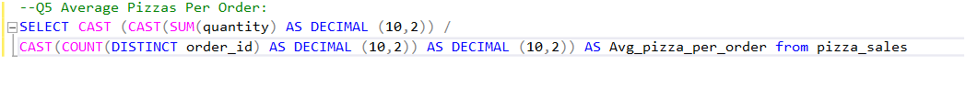



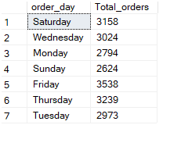

Q5.Determine average pizzas per order
Q6. Observe daily trends for total orders

Slide 7

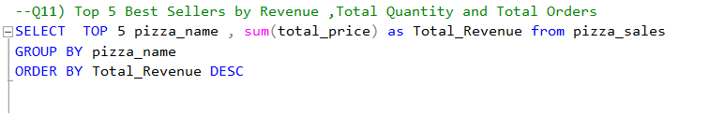
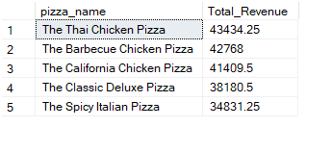
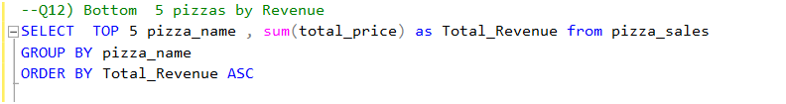
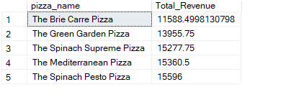
Q7.Determine Top 5 bestsellers by revenue
Q8.Bottom 5 pizzas by revenue

Slide 8
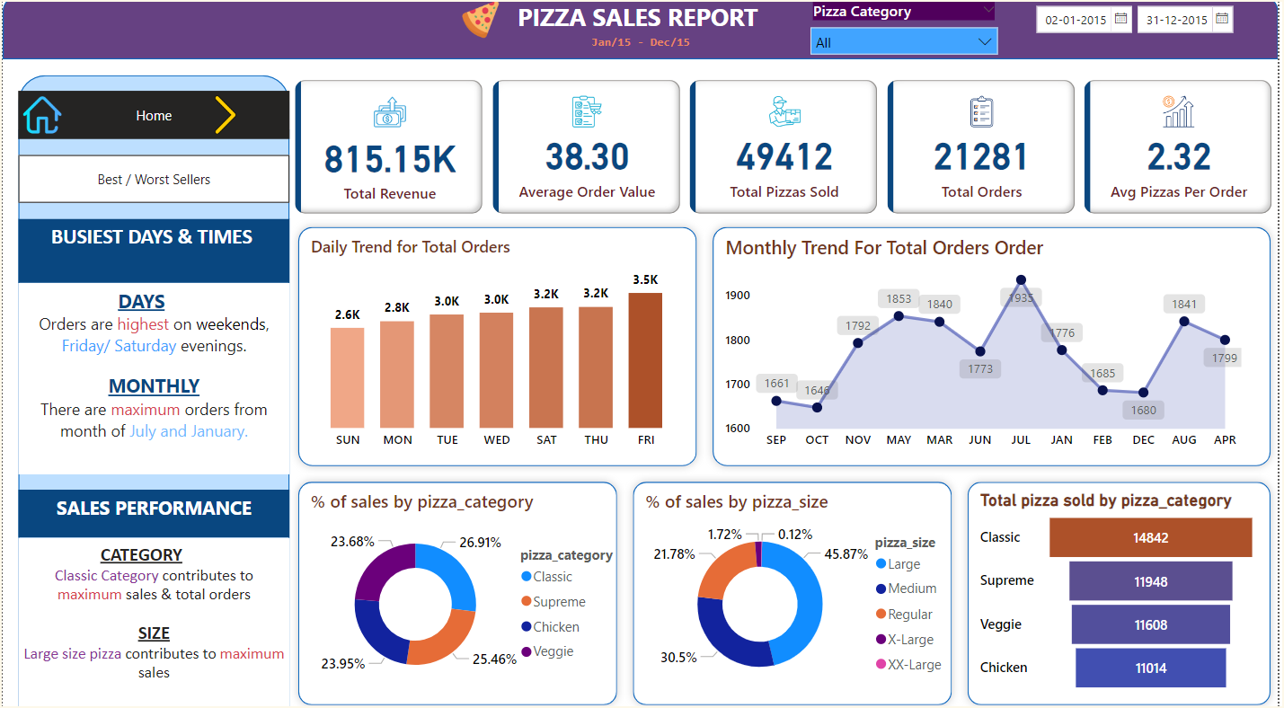

Slide 9
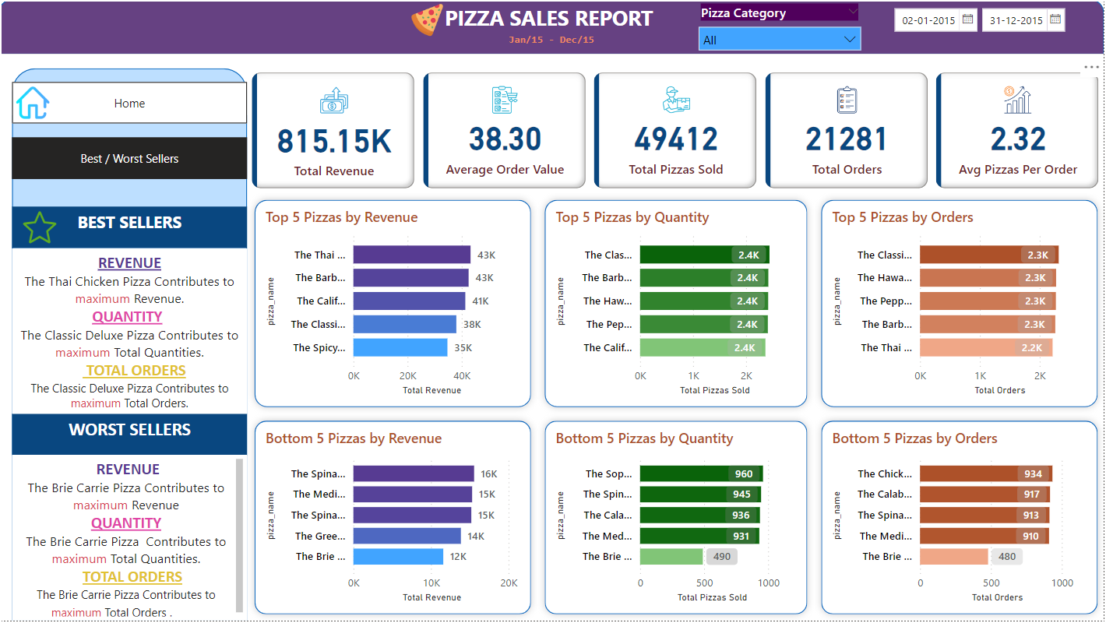

Slide 10

BUSINESS IMPACT:
1. Enhanced Sales Strategy: The dashboard supports data-driven decisions by identifying popular pizza types, peak sales hours, and high-demand pizza category, allowing for optimized inventory, targeted promotions, and refined product offerings to boost revenue.
2. Improved customer satisfaction: By analyzing customer preferences and feedback, the dashboard helps the business tailor its menu and marketing efforts to meet customer expectations, resulting in better customer retention and satisfaction.
3.Trend Identification and Forecasting: The dashboard’s ability to track sales trends over time aids in forecasting future demand, helping the business prepare for seasonal fluctuations and special events, thereby maximizing sales opportunities.

Slide 11
THANK YOU

